Slide 1

Quantum Communications Group
KML Implementation Proposal
Weekly Report
Supervisors:
Armando Nolasco Pinto
anp@ua.pt
Diogo Matos
dftm@ua.pt

Slide 2
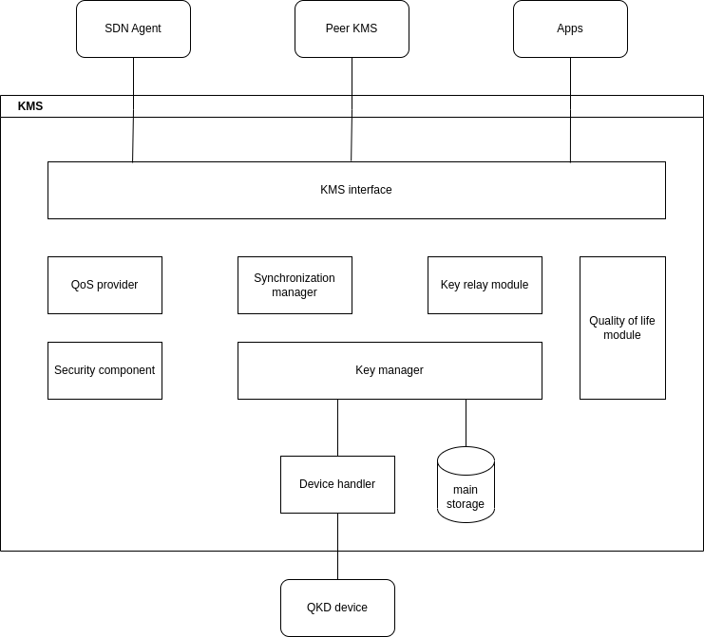
General Architecture KMS

Slide 3
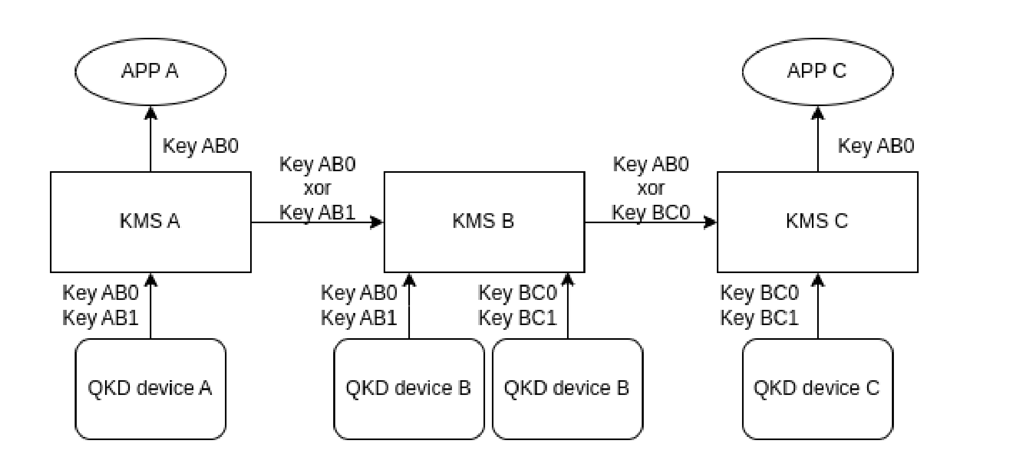
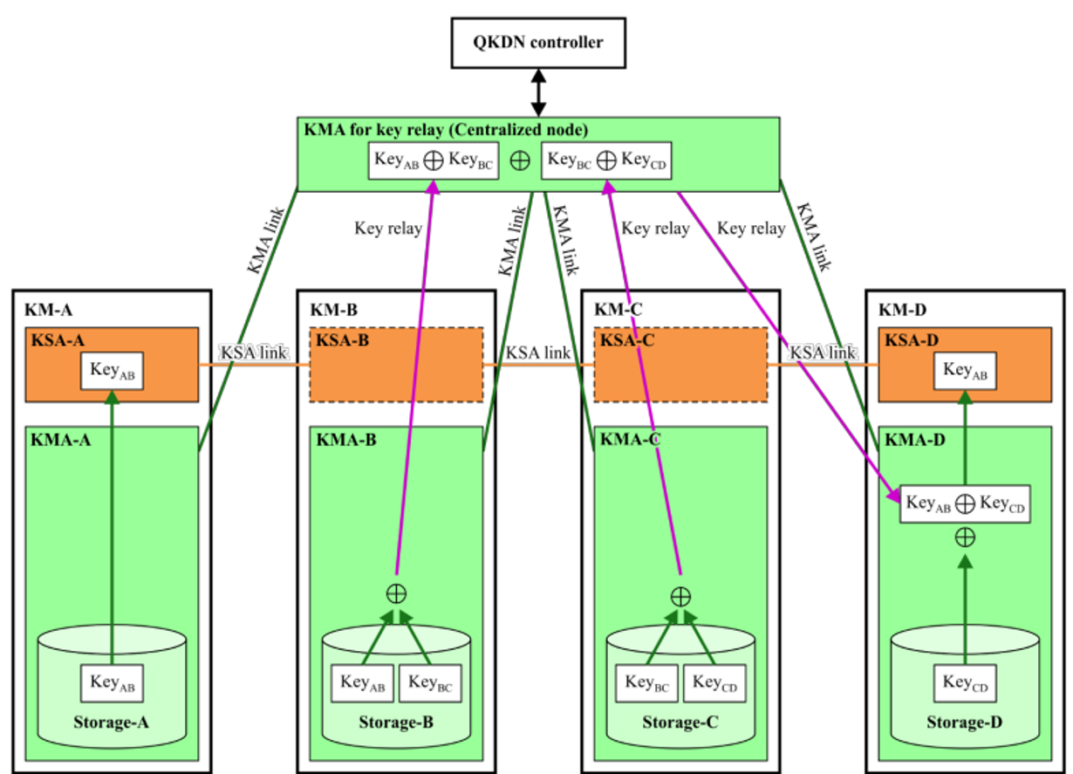
Key Relay
The basic key relay method is done by using One Time Pad (OTP) performing a XOR between the key to be relayed and a key that both peer KMSs know, this operation is done in each hop.
This key relay method requires all nodes to be trusted, in some specific cases that might be a problem. In a future implementation of the system more relay method can be added and used based on the security requirements on each end-to-end connection.
Notes:
O método básico de retransmissão de chave é feito usando One Time Pad (OTP) executar um XOR entre a chave a ser retransmitida e uma chave que ambos os KMSs pares conhecem
Esse processo de key relay é feito por um conjunto de KMSs (que estão conectados através de KMLinks), e o método de relay é feito usando One Time Pad. (fazendo um XOR entre a chave a ser transportada e a chave que ambos os KMSs conhecem

Slide 4
QOS provider
QoS provider Gathers and provides all QoS parameters to be used to negotiate with the applications and to send them to the SDN Agent when requested.
QOS parameters
Key_type: key type for the key stream (not approved yet)(uint32_t).
Key_chunk_size: Length of the key buffer requested by the application (uint32_t).
Max_bps: Maximum key rate requested in bits per second (uint32_t).
Min_bps: Minimum key rate requested in bits per second (uint32_t).
Jitter: Maximum expected deviation, in bps, for key delivery (uint32_t).
Timeout: Time, in msec, after which all will be aborted, returning an error.
TTL: Time after which the keys corresponding to this Key_stream_ID shall be erased(uint32_t).
Metadata mimetype: Field that defines the format of the metadata on each subsequent GET_KEY call.
Notes:
Reúne e fornece todos os parâmetros de QoS a serem usados ​​para negociar com as aplicações e enviá-los ao Agente SDN quando solicitado.

Slide 5
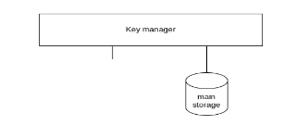
Key manager
Maintains and handles keys. Is mainly used for key material retrieval, storage, etc. It’s involved in almost any activity related with keys
Key storage
All keys are stored in a Database (DB) that’s accessed by the key manager in order to create and retrieve keys.
Notes:
Mantém e manuseia chaves. É usado principalmente para recuperação de materiais importantes, armazenamento, etc. envolvido em quase qualquer atividade relacionada com chaves
Todas as chaves são armazenadas em um Banco de Dados (BD) que é acessado pelo gerenciador de chaves para criar e recuperar chaves.

Slide 6
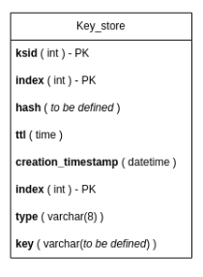
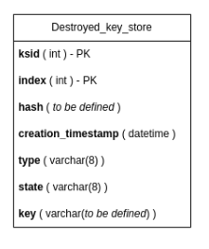
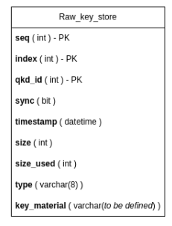
Key Storage / Main Storage
The DB is divided into three main tables, Raw_key_store stores key material from the physical layer, this material would be used to create keys requested by the applications, therefore is not considered as an already created key.

Slide 7
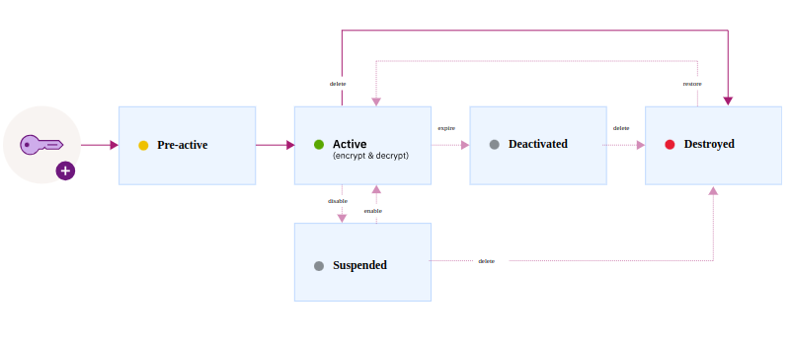
Key life-cycle in storage
Any key created has to go through its life-cycle, the following scheme represents a summary of the standard NIST(NIST SP 800-57).

Slide 8
Key Synchronization Module
Objective: Ensure keys across KMS systems align to provide accurate keys to applications.
Communication: Use KEY_SYNC messages to inform the peer KMSs about received keys since the last similar communication.
Protocol: The number of indexes in a message may vary, but both KMSs must agree on a consistent Key_chunk_size.
Actions on Receiving New Keys:
If an index was mentioned in a peer KMS's KEY_SYNC message and a minimum number of distinct indexes is reached, send a new KEY_SYNC message, marking received keys as synchronized (sync field at 1).
If a sent index wasn't mentioned in the peer's KEY_SYNC messages and the last notified index is higher, discard the keys.
Otherwise, store keys but mark them as unsynchronized (sync field at 0).
Updating Sync Field: Sync field of a key may later be updated based on received KEY_SYNC messages.
Discarding Not Synchronized Keys: Unsynchronized keys should be discarded after a configurable period to ensure ample time for the KMS to send KEY_SYNC messages.

Slide 9
Security Component
Implements all cryptographic algorithms used during the operation of the KMS.
Encryption is most importantly used in the communication between KMSs since all data is transmitted over the black network. Idealizing the use of QKD shared keys, the encryption of data can be as simple as a XOR, that is IT secure as long a different key is always used and its size it’s equal to the size of the data to encrypt.
Quality of life module
Handles several quality-of-life features such as logging and configuration.
Notes:
Não seria necessário a utilização de algoritmos mais complexos?

Slide 10
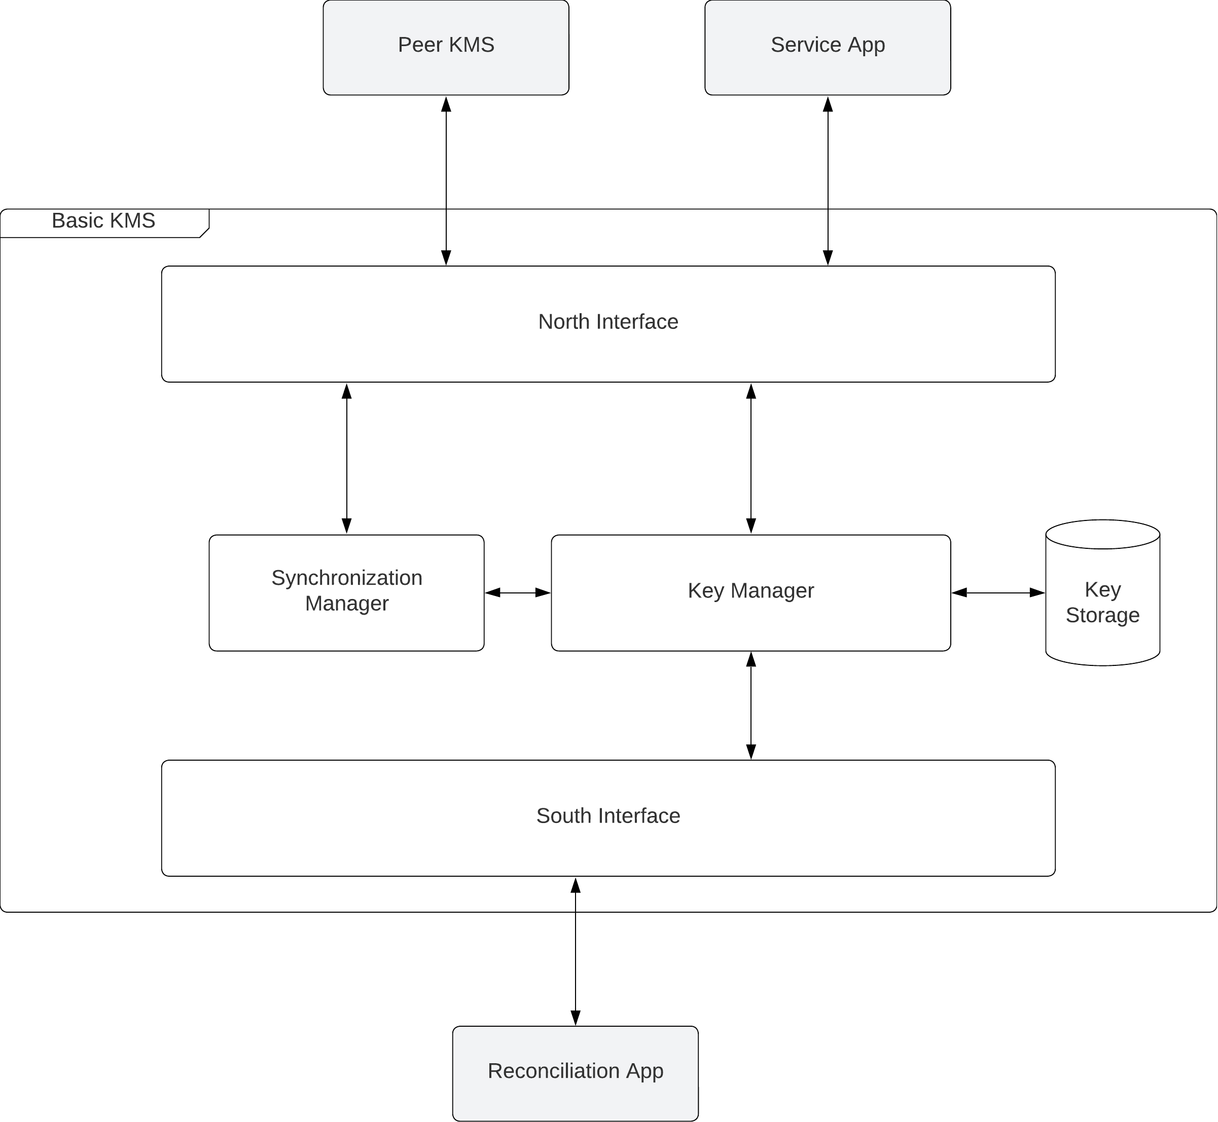
Architecture Basic KMS

